Slide 1
Network and Computer Security
Chapter 2 – Basic concepts
Prof. dr. ir. Eli De Poorter
© Eli De Poorter

Slide 2
Overview
A security model
Security goals
Security threats
Security mechanisms

Slide 3
Network security model
sender
(A, Alice,…)
receiver
(B, Bob,…)
message
Trusted 3rd Party
message
secret
information
secret
information
secure
message
information channel
secure
message
attacker
(C, Carol, Trudy,…)
Notes:
Modern security principles originate from Auguste Kerckhoffs in the 19th century: a cryptosystem should be secure even if everything about the system, except the key, is public knowledge (Kerckhoff’s principle). This means that typically the security transformation is publicly known (and is often standardized), and only the secret information (key) used in the security transformation to convert the message into a secure message is kept secret. The full method for secure information exchanges between A(lice) and B(ob) may require a prior exchange of several messages, including both data and control messages.
Alice and Bob are two commonly used placeholder names to make security exchanges easier to follow. The names are used for convenience; for example, "Alice sends a message to Bob encrypted with his public key" is easier to follow than "Party A sends a message to Party B encrypted by Party B's public key." These names were originally used by Ron Rivest in the 1978 Communications of the ACM article presenting the RSA cryptosystem, and in ”A Method for Obtaining Digital Signatures and Public-Key Cryptosystems” published April 4, 1977, revised September 1, 1977, as technical Memo LCS/TM82.
Alice and Bob are archetypes in cryptography, Eve is also common. Names further down the alphabet are less common. Other (less frequently used) names include:
Carol, Chuck, Carlos or Charlie, as a third participant in communications, sometimes with malicious intent.
Craig, the password cracker (usually encountered in situations with stored hashed/salted passwords).
Dan or Dave, a fourth participant.
Eve, an eavesdropper, is usually a passive attacker. While she can listen in on messages between Alice and Bob, she cannot modify them.
Trudy, a malicious attacker (an intruder). Unlike the passive Eve, this one is the active man-in-the-middle attacker who can modify messages, substitute his/her own messages, replay old messages, and so on. The difficulty of securing a system against Trudy is much greater than against Eve.
Walter, a warden, may be needed to guard Alice and Bob in some respect, depending on the protocol being discussed.
Wendy, a whistleblower, is an insider with privileged access who may be in a position to divulge the information.

Slide 4
Overview
A security model
Security goals
  Confidentiality
  Authentication
  Access control / authorization
  Data integrity
  Non-repudiation
  Availability
Security threats
Security mechanisms

Slide 5
Data confidentiality
Data confidentiality
  Data can only be read by those who are allowed to read these data
  Applications:
    Communicating confidential data between branches of a corporation
    Passwords
    Storage of health data
    etc.
  Oldest security service?
    Caesar cipher (Ancient Rome)
    Enigma code (Germany, WW II)
    etc.
Notes:
Confidentiality is translated as “vertrouwelijkheid” in Dutch.

Slide 6

Data confidentiality: threat
Alice
Bob
message
message
information channel
can read message
breach of confidentiality
Carol
Passive attack by Carol:
eavesdropping upon information channel
Notes:
E.g. Alice submits a tender for a procurement by Bob. Neither party uses any special security mechanism (e.g. simple communication using e-mail, ftp, etc.). Carol can read the transmitted message. Carol can then submit her own proposal, adapted using her knowledge of Alice’s offer.

Slide 7
Data confidentiality: solution
Alice
Bob
message
message
secret
information
secret
information
secure
message
information channel
secure
message
can no longer read message
confidentiality OK
Carol
Notes:
To make sure the message no longer is readable for Carol, a security transformation (encryption) is introduced, allowing only those (i.c. Alice en Bob) who have access to secret information (secret key) to recover the original message. Carol can still intercept the secure message, but she won’t be able to derive the original message from this.

Slide 8
Traffic-flow confidentiality
Traffic-flow confidentiality
  Keeping secret who’s communicating with whom
  Applications:
    Web surfer privacy protection
  Much harder to achieve than data confidentiality
    So-called Privacy Enhancing Techniques (PETs)
Notes:
As an examples of a existing privacy enhancing technologies (PET) communication anonymizers exist that hide the real online identity (email address, IP address, etc.) of a user and replacing it with a non-traceable identity (disposable / one-time email address, random IP address of hosts participating in an anonymizing network, pseudonym, etc.). A well-known PET is the onion routing protocol used by the Tor anonymous network.

Slide 9
Traffic-flow confidentiality: thread
Alice
Bob
message
message
secret
information
secret
information
secure
message
information channel
secure
message
Carol
can no longer read message
data confidentiality OK
still knows Alice is communicating with Bob
traffic-flow confidentiality not OK
Notes:
Passive attack by Carol: tapping the information channel between both parties A(lice) and B(ob).
With the solution for data confidentiality Carol can’t read the transmitted message any longer, but she can still deduce that Alice is communicating with Bob (e.g. from IP headers, or by analyzing the communication flow outgoing from Alice and incoming at Bob: “traffic-analysis”).

Slide 10
Confidentiality and privacy
Privacy
  Often confused with confidentiality
    Not every confidentiality requirement involves privacy
      E.g. intellectual property in a business requires confidentiality, no privacy
  Related to private life
    The right to choose what you divulge about yourself
    Culture dependent
    Fundamental right, legally protected since long
      Foundation for secrecy of correspondence
    Just like any fundamental right, this right isn’t unlimited

Slide 11
Overview
A security model
Security goals
  Confidentiality
  Authentication
  Access control / authorization
  Data integrity
  Non-repudiation
  Availability
Security threats
Security mechanisms
  Encryption
    Symmetric encryption
    Asymmetric encryption
  Hash functions
  Message authentication codes

Slide 12
Authentication
Authentication
  Related to identification
  Equivalent in “non-electronic” world
    Author of a letter is who he claims to be
    Person on the other side of the phone is who he claims to be
    Policeman ringing at the door indeed is a policeman
    Mobile phone battery is genuine
    etc.
  Guaranteeing the authenticity of a communication based on:
    Entity authentication
    Attribute authentication
    Data-origin authentication

Slide 13
Authentication
Entity authentication
  Entity
    Distinguished based on collection of data (attributes or characteristics)
        E.g. ID-number, mail address, ...
  Each entity has a unique identity
Identification
  Authentication of an entity’s identity
    Often used for entity authentication…
    …but a stronger requirement than simple entity authentication
  E.g. Logging in via biometrical means
Notes:
According to the Merriam-Webster dictionary, an entity is “something that has separate and distinct existence and objective or conceptual reality”. An entity typically has a number of attributes (or characteristics) that, taken together, form a unique combination. Entity authentication requires a validation to check if communicating parties are who they claim to be. In practical implementations, entity authentication is often based on authentication of some attributes of these entities. An example is a person’s first name, last name, date and hour of birth and place of birth that together uniquely identify a person. Alternatively, the identity number of a passport is also an attribute that uniquely identifies a person.
Identification is used when an identity needs to be uniquely represented and the identity needs to be validated. An example where entity authentication doesn’t really require the entity's identification is the registration with many websites. During registration the user generates a login and password, and provides some data (name, address, email address, etc.) to the website. Typically the only important data is the e-mail address (to which possibly the password will be sent), while all other data absolutely don’t need to be authentic. The next time the user logs in to this website, he’ll be authenticated via the login and password (he is then deemed the authentic owner of this couple). But one can’t assert his identity is authentic, since it wasn’t really verified at any time.

Slide 14
Authentication
Attribute authentication
  attribute
    Characteristic of an entity
    Possible attributes
      Identity
      Function
      etc.
  Communicating parties exhibit the characteristics they claim to have
    An entity is often authenticated through the authentication of some of its attributes
Notes:
An already sufficiently authenticated entity (e.g. using an electronic identity card, which adequately captures the identity of a communicating entity) may need to authenticate additional attributes (e.g. the fact that he is a doctor to access certain medical information).

Slide 15
Authentication
Data-origin authentication
  The data indeed originates from the specified source
  Important to evaluate whether data is reliable
    Based on reliability of their origin
    Part of data integrity (cf. further on)
  Difference with entity authentication
    No interaction with data source
    Not all solutions for entity authentication will be operative

Slide 16
Authentication: threat
Alice
I’m “Alice”
Bob
message
message
Carol
I’m “Alice”
message
information channel
Bob receives message from Carol,
but thinks message originates from Alice
entity “Alice” not authentic
Notes:
Active attack by Carol on the communication between Alice and Bob, e.g. by hijacking the communication, or more simply by sending a forged message.
Example 1) Alice communicates with website of Bank Bob. Bob needs to know whether it is indeed Alice who logs in, and not Carol masquerading as Alice in order to gain access to Alice’s accounts at Bank Bob. (authenticity of the entity Alice; conversely, Alice may also want to be sure she’s communicating with the website of Bank Bob and not with a fake website set up by Carol).
Example 2) Bob has received a message from software vendor Alice (e.g. by email) with a major security patch for the software in attachment. Before Bob installs the patch, he’d like to be certain it really originates from Alice… and isn’t some piece of malware coming from Carol. (authenticity of the origin of the data received by Bob).

Slide 17
Authentication: solution
Alice
Bob
I’m “Alice”
I’m “Bob”
message
message
secret
information
security transformation
verification
message
information channel
message
security
security
only known to Alice
adding “signature” to message
verifiable by Bob – entity “Alice” authentic
Carol can’t forge this “signature”
Notes:
Make sure Carol can’t generate a message in which she claims to be someone else anymore. Add some “signature” to Alice’s message. This “signature” binds the entity Alice to the contents of the message, so it must:
be linked to the message (another message has a different “signature”)
be based on secret information only Alice possesses
be verifiable, even by those who don’t know this secret information
The digital signature is based on this principle, and also guarantees the authenticity of the origin of the data.
Note that a potential threat still lurks in this diagram. If Carol eavesdrop upon the information channel she still can intercept a secure message and then forward it again to Bob and in this way still impersonate Alice (replay).
An alternative solution is for Alice to use an (encrypted) password as secret information, that Bob will recognise as Alice’s. The danger is that Carol still can eavesdrop on the forwarded password and then use it again (sometimes even if it is encrypted). A remedy against this threat is to ensure the communication between Alice and Bob can also be confidential. A possible implementation could be: sending the password over a TLS/SSL connection (see later for TLS/SSL).

Slide 18
Overview
A security model
Security goals
  Confidentiality
  Authentication
  Access control / authorization
  Data integrity
  Non-repudiation
  Availability
Security threats
Security mechanisms
  Encryption
    Symmetric encryption
    Asymmetric encryption
  Hash functions
  Message authentication codes

Slide 19
Access control / authorisation
Access control and authorisation
  Determines which user may access which resources (data, computation time, etc.)
  Equivalent in “non-electronic” world
    Only people with a valid entrance ticket may attend a concert
    Special member card required for some shops
    Only attending physician has access to patient’s medical information
    etc.
  Requires authentication of the entity requesting access to these resources
    System determines to what extent entity may access those resources
    Access rights may depend on entity itself or its attributes

Slide 20
Access control / authorisation
Access control and authorisation
  illustration 1: access control in OS
    Authentication through login and password
      Determines which user is at the computer
    Access control determined for this user (entity)
      Full access (read, write, delete, etc.) to own files
      Limited access (e.g. read) to some other files (e.g. some system files)
      No access to other files (e.g. files belonging to other users)
    Access rights different from user to user

Slide 21
Access control / authorisation
Access control and authorisation
  illustration 2: access control to medical database
    Different rights for different types of users
      E.g. physicians, nurses, patients, etc.
    Requires authentication based on specific attributes
    Access rights depend on attributes of the user
    Access rights different from user type to user type (roles)
      Role based access control

Slide 22
Overview
A security model
Security goals
  Confidentiality
  Authentication
  Access control / authorization
  Data integrity
  Non-repudiation
  Availability
Security threats
Security mechanisms
  Encryption
    Symmetric encryption
    Asymmetric encryption
  Hash functions
  Message authentication codes

Slide 23
Data integrity
Data integrity
  Guarantee that sent data and received data are identical
    No tampering with data en route
    Nothing was added
    Nothing was deleted
    Nothing was modified
    Nothing was replayed
  Stronger requirement than data origin authentication

Slide 24
Data integrity
Data integrity
  Equivalent in “non-electronic” world
    No text was added after the signature of a contract
    The invoice date is correct
    No “creative” accounting
    No information was withheld
    Vote cast was effectively registered
    etc.

Slide 25
Data integrity: threat 1
Alice
Bob
message
message
pay
EUR 100.00
to David
pay
EUR 100.00
to David
information channel
pay
EUR 100.00
to David
pay
EUR 100.00
to Carol
Carol
Additional payment instruction is received
no data integrity
Notes:
E.g. Alice sends message to bank Bob instructing to pay EUR 100.00 to David. Alice would like that this exact amount is paid to D(avid)…and that no other payments are stealthily executed.
Active attack by Carol: injection of an additional message.

Slide 26
Data integrity: threat 2
Alice
Bob
message
message
pay
EUR 100.00
to David
pay
EUR 100.00
to Carol
information channel
pay
EUR 100.00
to David
Carol
Modified payment instruction
no data integrity
Notes:
E.g. Alice sends message to bank Bob instructing to pay EUR 100.00 to David. Alice would like that this exact amount is paid to D(avid)…and not to some other person.
Active attack by Carol: message modification.

Slide 27
Data integrity: threat 3
Alice
Bob
message
message
pay
EUR 100.00
to David
pay
EUR 100.00
to David
pay
EUR 100.00
to David
information channel
pay
EUR 100.00
to David
Carol
Payment instruction is executed more than once
no data integrity
Notes:
E.g. Alice sends message to bank Bob instructing to pay EUR 100.00 to David. Alice would like that this exact amount is paid to D(avid)…and doesn’t want a double execution of the payment.
Active attack by Carol: fraudulent reuse of data (“replay”).

Slide 28
Data integrity: solution
pay
EUR 100.00
to David
+ ‘seq. No.’
Alice
Bob
pay
EUR 100.00
to David
+ ‘seq. No.’
message
message
secret
information
security transformation
verification
pay
EUR 100.00
to David
+ ‘seq. No.’
secure
message
information channel
secure
message
pay
EUR 100.00
to David
+ ‘seq. No.’
pay
EUR 100.00
to David
+ ‘seq. No.’
security
Carol
security
only known to Alice
security
can only be generated
by Alice
Carol can’t change message,
can‘t insert message,
can‘t replay message
without Bob noticing
Notes:
In this case, a digital signature can be a solution. This signature makes it impossible for Carol surreptitiously to modify a message or to insert a message that hasn’t been created by Alice.
The sequence number added to the communication aims at thwarting a “replay”. In practice, this won’t be a simple serial number (e.g. 0,1,2,etc.), but it will satisfy some security requirements (to avoid the replay of an old sequence number in a later session). A possible choice may be the use of a (sufficiently large) “nonce”, which is incremented for each subsequent message. Another possibility is to use a time value instead of a regular sequence number (but beware of desynchronised clocks).
Some use modes of symmetric encryption may also thwart replay attacks (see later).
Observe that this schema doesn’t guarantee full data integrity, as Carol could still cause the message not to reach Bob. This aspect of data integrity can only be achieved with a bi-directional communication between Alice and Bob (receipt acknowledgement).

Slide 29
Overview
A security model
Security goals
  Confidentiality
  Authentication
  Access control / authorization
  Data integrity
  Non-repudiation
  Availability
Security threats
Security mechanisms
  Encryption
    Symmetric encryption
    Asymmetric encryption
  Hash functions
  Message authentication codes

Slide 30
Non-repudiation
Non-repudiation
  For sender
    Sender can’t deny having sent the message
    Important for receiver
  For receiver
    Receiver can’t deny having received the message
    Important for sender
Equivalent in “non-electronic” world
  Being able to prove an order has been placed
  Being able to prove an invoice has been paid
  etc.
Notes:
Repudiation is translated in Dutch as “verwerping”, “ontkenning” or “verloochening”.
In order to achieve non-repudiation (for the sender) for a transaction, the receiver should be able to prove that the sender did send this message. This implies measures have been taken to ensure an intruder couldn’t have sent the message, i.e.:
Sender authentication
Data integrity of the communication between sender and receiver
The receiver will have to keep the “signature” of the message
The schema shown for data integrity would achieve these goals.
Non-repudiation for the receiver is harder to achieve. It requires a reaction from the receiver to the sender. The non-repudiation of this reaction guarantees the desired functionality.

Slide 31
Overview
A security model
Security goals
  Confidentiality
  Authentication
  Access control / authorization
  Data integrity
  Non-repudiation
  Availability
Security threats
Security mechanisms
  Encryption
    Symmetric encryption
    Asymmetric encryption
  Hash functions
  Message authentication codes

Slide 32
Availability
Meaning
  System/service is accessible and usable for authorised users
Equivalent in “non-electronic” world
  Store accessible during opening hours
    Could be prevented by protesters
  Polling stations allow users to vote on election day
    Could be hindered by political unrest
    NO attack: insufficient number of polling stations (e.g. Ohio 2004)
      Just poor design
  etc.

Slide 33
Availability: threat 1
Alice
Bob
message
message
information channel
…
message
Carol
message
message
message
message
message
message
Bob is swamped by the torrent of messages from Carol
Bob’s service no longer is accessible
DoS: denial-of-service
Notes:
E.g. Alice requests information from website Bob. Under normal circumstances Bob should be able to receive, process, and answer Alice’s message.
Carol executes an active attack: denial-of-service. This requires a high throughput broadband access (university networks are sometimes used as launch pads for this kind of attacks). Authentication of communicating parties makes such an attack a lot harder (although the initial phase of the authentication protocol could still be attacked).

Slide 34
Availability: threat 2
Alice
Bob
message
message
Carol 9324
information channel
…
Carol 735
Carol 1
message
message
message
message
message
Carol 2
message
message
Carol 23
Carol 158
Carol 735
Bob is swamped by the torrent of messages
from multiple (and numerous) senders
Bob’s service no longer is accessible
DDoS: distributed denial-of-service
Notes:
E.g. Alice requests information from website Bob. Under normal circumstances Bob should be able to receive, process, and answer Alice’s message.
“Carols” execute an active attack: distributed denial-of-service. A large number of attackers Carol 1, Carol 2, etc. overwhelm Bob’s website under a torrent of messages. These messages may come from:
A large group of participants
A large group of computers contaminated by malware, where unsuspecting users are deployed for the attack (e.g. MyDoom.A worm, which performed a successful DoS attack against the SCO website)
Broadband access isn’t required for this kind of attack (regular DSL or cable will be largely sufficient). This attack is much harder to fend off than regular DoS.
Practical solutions against DDoS typically involve non-cryptographic techniques (firewall, IDS, etc.) that analyse incoming communications so that anomalies can be detected and dealt with (filtering out the anomalous traffic). If needed, it may be desirable to operate a temporary graceful shutdown of the service (which is still to be preferred over a system crash, possibly involving some data loss).

Slide 35
Overview
A security model
Security goals
  Confidentiality
  Authentication
  Access control / authorization
  Data integrity
  Non-repudiation
  Availability
Security threats
Security mechanisms
  Encryption
    Symmetric encryption
    Asymmetric encryption
  Hash functions
  Message authentication codes

Slide 36
Security threat: attacks
Passive attacks
  Eavesdropping
  Traffic analysis
Active attacks
  Message insertion / modification
  Impersonation / masquerade
  Replay
  Denial-of-Service (DoS)
  Hijacking
    taking over existing connection, where attacker replaces sender or receiver
Notes:
Passive attacks offer a more limited potential to the attacker, but they are significantly harder to detect, as they don’t modify the transmitted data. This is certainly true if part of the communication channel is totally open (e.g. a wireless connection). Active attacks do modify the transmitted data or the data stream, and can thus be detected more easily. However, they give the attacker a lot more options.

Slide 37
Security threat: attacks
Possible attacks
  Brute force
    Trying out all possible keys until correct key is found
  Cryptanalysis
    More subtle attacks using knowledge about structure of algorithm, and possibly also additional knowledge of pairs (plaintext message, secure message), in order to recover plaintext message or key itself, or to forge secure message
  Side-channel attacks
    Even more subtle attacks using the physical properties (power, computation time, electromagnetic radiation, etc.) or fault injection in order to recover the plaintext or the key

Slide 38
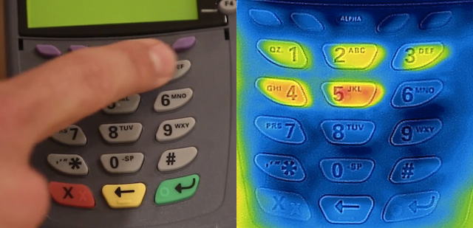
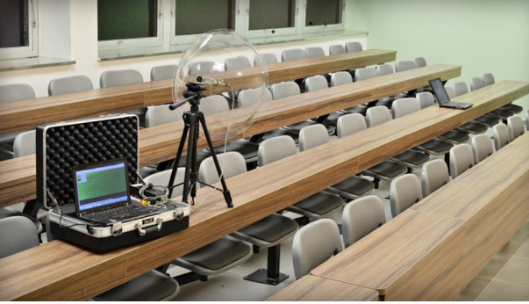
Security threat: attacks
Example side channel attacks
Here’s How iPhone Thermal Cameras Can Be Used to Steal Your Pin Codes, Petapixel, August 29, 2014
Researchers crack the world’s toughest encryption by listening to the tiny sounds made by your computer’s CPU, http://www.extremetech.com, December 18, 2013
Notes:
Timing information, power consumption, electromagnetic leaks or even sound can provide an extra source of information, which can be exploited to break the system.
http://petapixel.com/2014/08/29/heres-iphone-thermal-cameras-can-used-steal-pin-codes/
http://www.extremetech.com/extreme/173108-researchers-crack-the-worlds-toughest-encryption-by-listening-to-the-tiny-sounds-made-by-your-computers-cpu

Slide 39
Security threat: attacks
Categories of attacks
  “Ciphertext only”
    Only secure message (ciphertext) is known to attacker
  “Known plaintext”
    One or more pairs (plaintext, ciphertext) obtained with a single key are known to attacker
  “Chosen plaintext”
    Requires one or more pairs (plaintext, ciphertext) obtained with a single key, where plaintext was chosen by attacker
  “Chosen ciphertext”
    Requires one or more pairs (plaintext, ciphertext) obtained with a single key, where ciphertext was chosen by attacker
      Corresponding plaintext may be “garbage”
  “Chosen text”
    A combination of both “chosen plaintext” and “chosen ciphertext”
Notes:
The term ciphertext (or secure message) typically refers to the encrypted message, whereas the term plaintext is used for the original text. The same terminology is used for text or other data structures, since any digital data source can be represented as plaintext. “Ciphertext only” attacks can be mounted using information that is readily available to the attacker (it only requires eavesdropping upon the information channel). It is however much harder to perform successful cryptanalysis with a “ciphertext only” attack. Conversely, it may be very hard to mount a “chosen text” attack as finding the desired (plaintext, ciphertext) pairs is typically hard. However, it offers more opportunities for cryptanalysis.
Some algorithms are very safe against “ciphertext only” attacks, but won’t withstand other types of attacks. This may be acceptable if the algorithm is used correctly. Other algorithms will even withstand a “chose text” attack. This is something to bear in mind when considering security mechanisms.

Slide 40
Security threat: attacks
Desired degree of security?
  Unconditionally secure
    Impossible to invert security transformation without knowing the secret information
    No practical security mechanism achieve this
  Computationally secure
    The cost of breaking the encryption is larger than the value of the information
    The time required for breaking the encryption is longer than the useful lifetime of the information
    All practical algorithms discussed in this course are in this category

Slide 41
Overview
A security model
Security goals
  Confidentiality
  Authentication
  Access control / authorization
  Data integrity
  Non-repudiation
  Availability
Security threats
Security mechanisms
  Encryption
    Symmetric encryption
    Asymmetric encryption
  Hash functions
  Message authentication codes

Slide 42
Symmetric encryption
Basic operation
Secret key, for both
encryption and decryption
Sender
Alice
Receiver
Bob
plaintext
message
plaintext
message
encryption
decryption
ciphertext
message

Slide 43
Symmetric encryption
Principle:
  Transforms plaintext message into encrypted message
    Transformation using secret key
  Inverse operation: decryption
    Transforming the encrypted message into a plaintext message
    Using the same secret key
    Practically infeasible to decrypt without knowing the secret key
Secret key size
    40 bits: weak security
    128 or more bits: (very) strong security
Notes:
Symmetric encryption is the most traditional form of encryption and is also referred to as “conventional encryption”.

Slide 44
Symmetric encryption: confidentiality
Secure storage of sensitive information
  Only encrypted files are stored
    Only owner of secret key can decipher encrypted files
    Lost laptop doesn’t imply breach of confidentiality
      However loss of key implies loss of data
  Only secret key needs to be protected
    E.g. Storage on separate support
Secure transmission of sensitive information
  Eavesdropping upon communication channel doesn’t yield useful information
  Sender and receiver must share secret key
    Sender and receiver need to trust each other
    Requires different secret key for each pair of communicating users

Slide 45
Symmetric encryption: authentication
Authentication of communicating entity A(lice)
  Only A(lice) can use this specific key in a communication with B(ob)
Drawbacks
  Server B(ob) needs to know the secret key of each party that wants to communicate with B(ob)
    Unwieldy + vulnerable
  No 100% authenticity of data-origin for message
    B(ob) too could have generated this message

Slide 46
Example: Caesar Cipher
Original
  replace each letter by letter 3 places shifted in the alphabet
  transformation:
Mathematically
  Give each letter a number
  a b c d e f g h i j k l m n o p q r s t u v w x y z
  0 1 2 3 4 5 6 7 8 9 10 11 12 13 14 15 16 17 18 19 20 21 22 23 24 25
  Caesar cipher:
  c = ciphertext = E(p) = (p + k) mod (26)
  p = plaintext = D(c) = (c – k) mod (26)
Example:
meet me after the toga party
PHHW PH DIWHU WKH WRJD SDUWB
Notes:
Substitution ciphers are encryption methods where letters of plaintext are replaced by other letters or by numbers or symbols. Whilst the early Greeks described several substitution ciphers, the first attested use in military affairs of one was by Julius Caesar, described by him in Gallic Wars. We call any cipher using a simple letter shift a caesar cipher, not just those with shift 3 as originally used.
This mathematical description uses modulo (clock) arithmetic. Here, when you reach Z you go back to A and start again. Mod 26 implies that when you reach 26, you use 0 instead (i.e. the letter after Z, or 25 + 1 goes to A or 0).
Example: howdy (7,14,22,3,24) encrypted using key f (i.e. a shift of 5) is MTBID

Slide 47
Cryptanalysis of Caesar Cipher
Disadvantages
  Only 26 possible ciphers
Brute force search
  Simply try each in turn
  eg. break ciphertext "GCUA VQ DTGCM“
Notes:
With a Caesar cipher, there are only 26 possible keys, of which only 25 are of any use, since mapping A to A etc doesn't really obscure the message! An attacker can try each of the keys (shifts) in turn, until can recognise the original message.
Note: as mentioned before, you need to be able to recognise when have an original message (i.e. is it English). Usually easy for humans, hard for computers. Visually recognizing the presence of an original message is much harder when compressed data is used.

Slide 48
Symmetrical encryption algorithms
Can be made more robust by
  Larger key sizes
  Introduction of permutations
  Exploiting mathematical complexities
Advanced methods
  DES
  3 DES
  AES
  Twofish
  Blowfish
  RC4
  IDEA
  Serpent
  ...
These will be discussed in chapter 4

Slide 49
Overview
A security model
Security goals
  Confidentiality
  Authentication
  Access control / authorization
  Data integrity
  Non-repudiation
  Availability
Security threats
Security mechanisms
  Encryption
    Symmetric encryption
    Asymmetric encryption
  Hash functions
  Message authentication codes

Slide 50
Asymmetric encryption
Symmetric encryption
  A few drawbacks:
    Both sender and receiver need to know the secret key
    How to exchange this key?
  Alternative technique might be useful

Slide 51
Asymmetric encryption
Asymmetric encryption or “public key encryption”
  Instead of secret key for each pair of users
  Key pair for each user
    A private key
      Only to known to user himself
    A public key
      Public to everyone
      Preferably as public as possible
  Principle:
    No useful information may be derived about private key from knowledge of public key
    Typically relies on hard mathematical problems
      E.g. factorisation of the product of 2 large primes
Notes:
In this course we use the expression “private key” for the secret information in an asymmetric encryption algorithm, and the expression “secret key” for the secret information in a symmetric encryption algorithm. The sole purpose of this wording is to distinguish between both types of algorithms. However, in literature about security and cryptography one may occasionally encounter the expression “secret key” for asymmetric encryption. The context should make clear whether one is dealing with a symmetric or with an asymmetric algorithm.
A consequence of the reliance on a hard mathematical problem is that the security of the algorithm is threatened not only by increasing computer power, but also by possible improvements in the solution techniques of the mathematical problem. This happened in the 90’s with prime factorisation. The complexity of solving this problem was significantly reduced by the introduction of the GNFS and may even be further reduced in the future, hereby threatening RSA for not too long a key length (1024 bits; 768 bits should be considered broken by now).

Slide 52
Asymmetric encryption: confidentiality
public key
Bob
private key
Bob
sender
Alice
receiver
Bob
plaintext
message
plaintext
message
encryption
decryption
ciphertext
message
Notes:
In a key pair for asymmetric encryption we write KU_{A} for A’s public key van A, and KR_{A} for A’s private key.

Slide 53
Asymmetric encryption: confidentiality
Concept
  Transforms plaintext message into ciphertext message
    Transformation using the public key of the receiver of the message
  Inverse operation: decryption
    Converting ciphertext message into plaintext message
    Using receiver’s private key
  Only the owner of the private key can decrypt the message
Comparison with symmetric encryption
  No longer required to exchange secret key
  Typically much longer keys…
  …that aren’t more secure
    1024 bits RSA offers lower security than 128 bits AES
  Much slower (by 2 to 3 orders of magnitude)
    No replacement, but complement:
      E.g. encrypting secret key for symmetric encryption

Slide 54
Asymmetric encryption: authentication
private key
Alice
public key
Alice
sender
Alice
receiver
Bob
plaintext
message
plaintext
message
encryption
decryption
ciphertext
message

Slide 55
Asymmetric encryption: authentication
Concept
  Transform plaintext message into ciphertext message
    Using the private key of the sender of the message
      Only the owner of the private key can encrypt the message in this way
      Kind of sender’s “signature” for this message
  Inverse operation: decryption
    Converting ciphertext message into plaintext message
    Using sender’s public key
      Verification of sender’s authenticity
      Verification of message data-integrity (partially)
      Sender must own private key corresponding to this public key
    Requires knowledge of public key ownership
Notes:
Data-integrity is only partially achieved. It is indeed impossible for an attacker to modify the message, but without additional measures, the attacker could still replay or suppress the message. This is sometimes called message authentication.

Slide 56
Asymmetric encryption
Confidentiality + authentication
private
key
Alice
public
key
Bob
private
key
Bob
public
key
Alice
sender
Alice
receiver
Bob
plaintext
message
plaintext
message
encryption
decryption
ciphertext
message

Slide 57
Asymmetric encryption
Combining confidentiality + authentication
  Only sender A(lice) can send message encrypted using A(lice)’s private key
    Authenticity of entity A(lice)
    Data-integrity of message (partially)
    To be verified using A(lice)’s public key
  Only receiver B(ob) can decrypt message that was encrypted using B(ob)’s public key
    Confidentiality of communication between A(lice) and B(ob)
  Requires that each party knows the public key of the other party

Slide 58
Asymmetric encryption
Asymmetric encryption
  Drawbacks
    Slow
    Impractical to encrypt full message using asymmetric algorithm in order to achieve authentication
  Combination with symmetric encryption for confidentiality
    See SSH, PGP, ...
  Combination with hash functions for authentication
  Suitable for short messages
    E.g. key exchange

Slide 59
Assymetrical encryption algorithms
Examples:
  RSA (Rivest – Shamir – Adleman)
  ElGamal
  ECC (Elliptic Curve Cryptography)
  Diffie-Hellman
  XTR
These will be discussed in chapter 4

Slide 60
Overview
A security model
Security goals
  Confidentiality
  Authentication
  Access control / authorization
  Data integrity
  Non-repudiation
  Availability
Security threats
Security mechanisms
  Encryption
    Symmetric encryption
    Asymmetric encryption
  Hash functions
  Message authentication codes

Slide 61
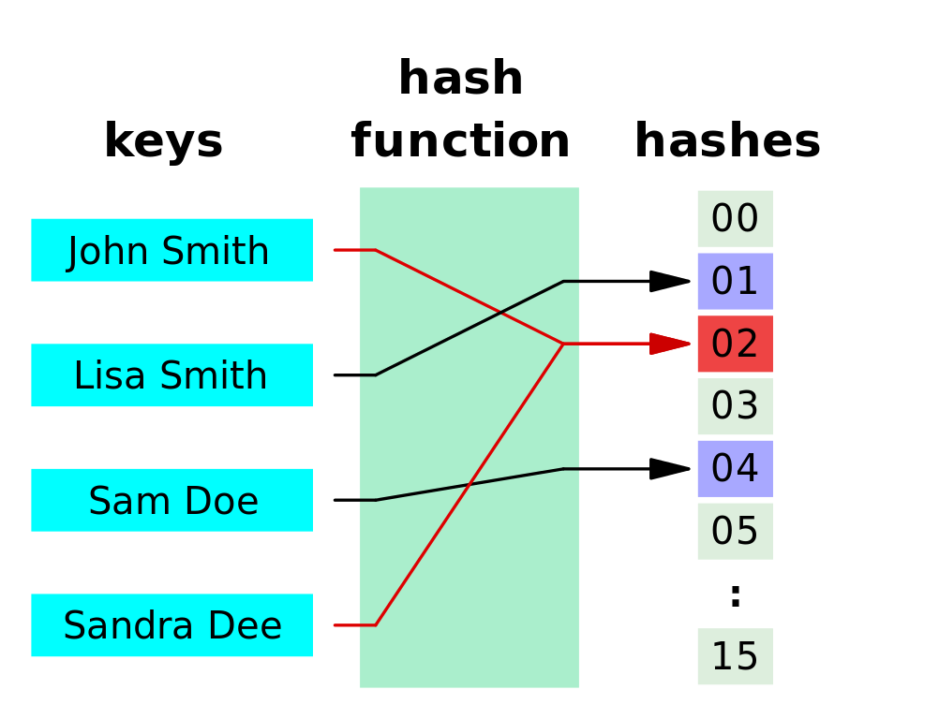
Hash functions
Used in programming / databases to speed-up lookups
  Associate a short identifier to an entry
Also used for
  Checksums, check digits, error correcting codes, …
  And of course: security!
Notes:
Hash functions are primarily used in hash tables, to quickly locate a data record (e.g., a dictionary definition) given its search key (the headword). Specifically, the hash function is used to map the search key to an index; the index gives the place in the hash table where the corresponding record should be stored. Typically, the domain of a hash function (the set of possible keys) is larger than its range (the number of different table indexes), and so it will map several different keys to the same index. Therefore, each slot of a hash table is associated with (implicitly or explicitly) a set of records, rather than a single record. For this reason, each slot of a hash table is often called a bucket, and hash values are also called bucket indices. Thus, the hash function only hints at the record's location — it tells where one should start looking for it. Still, in a half-full table, a good hash function will typically narrow the search down to only one or two entries. The figure demonstrates a hash function that maps names to integers from 0 to 15. There is a collision between keys "John Smith" and "Sandra Dee".
A checksum or hash sum is a small-size datum from a block of digital data for the purpose of detecting errors which may have been introduced during its transmission or storage. It is usually applied to an installation file after it is received from the download server. By themselves checksums are often used to verify data integrity, but should not be relied upon to also verify data authenticity.
A check digit is a form of redundancy check used for error detection on identification numbers (e.g. bank account numbers) which have been input manually. It is analogous to a binary parity bit used to check for errors in computer-generated data. It consists of a single digit (sometimes more than one) computed by an algorithm from the other digits (or letters) in the sequence input.
Forward error correction (FEC) or channel coding are techniques used for controlling errors in data transmission over unreliable or noisy communication channels. The central idea is the sender encodes the message in a redundant way by using an error-correcting code (ECC). The redundancy allows the receiver to detect a limited number of errors that may occur anywhere in the message, and often to correct these errors without retransmission.

Slide 62
Hash functions
Alternative terms
  “hash code”
  “message digest”
Notation: h = H(M)
  Fixed number of bits
    128 for MD5, 160 for SHA-1
Acts as a “fingerprint”
  Used for modification detection
    Changing messages changes corresponding hash value
  By itself not secure
    E.g. no authentication

Slide 63
Hash functions
sender Alice
receiver Bob
plaintext
message
plaintext
message
plaintext
message
hash
fctn
private
key
Alice
Hash
Hash
public
key
Alice
hash
fctn
compare
Hash
encr.
decr.
Notes:
In this use of a hash function for message authentication, an asymmetric encryption algorithm is used (to encrypt the non-secret hash value). Authentication of communicating entity A(lice) is provided, since only A(lice) can use this particular key in communication with B(ob). Authentication of the sent message is provided, since a modified message would correspond to different (encrypted) hash value. To further ensure that message tampering is not possible, a counter sequence is typically added to the message and encrypted together with the hash value.
The encrypted hash value is the “digital signature” of the corresponding plaintext message. This is one of the most common schemes for digital signatures (see later), where RSA or ElGamal can be used as an encryption algorithm.

Slide 64
Hash functions: requirements
Should be able to work for input messages of any length
One-way function
  Given h, infeasible to find message x so that h=H(x)
Weak collision resistance
  Given message x, infeasible to find message y (≠x) so that H(y)=H(x)
Strong collision resistance
  Infeasible to find different messages x and y so that H(y)=H(x)
Hash values must be easy to compute (?)
Notes:
The main goal of the “one-way function” property is to make it impossible to recover the original message from the hash value only. This is generally not a major issue as a hash function typically maps a huge message space on a much smaller hash value space. This is however essential when the message space is rather small (e.g. when hashing passwords).
We’ll see why weak and strong collision resistance are important when dealing with the generation of digital signatures. Both forms of collision resistance requirement exclude too simple and too naive hash function implementations (e.g. using XOR operations).
Strong collision resistance isn’t required for all applications.
Note that the requirement “easy to compute” is not always valid. When encrypting passwords, special hash algorithms or “key derivation functions” (such as bcrypt, scrypt or PBKDF) are used that require more time to compute. This has the advantage that attackers that somehow gain access to the hashed passwords can’t too easily calculate which hash code is derived from each password. Algorithms such as bcrypt include adaptive functionality: over time, the variables such as the iteration count can be increased to make it slower in order to keep the algorithm resistant to brute-force search attacks even with increasing computation power.

Slide 65
Hash functions
Can we replace the plaintext from Alice?
Weak collision resistance requirement
  If absent, possible to replace plaintext message with different message with same hash value
    Will indeed yield same encrypted hash value
    No knowledge of private key required
    No longer guaranteed message origin authentication or data-integrity
Notes:
For a good hash function with n bits hash value, generating a forged message should be hard, typically in the order of 2^{n}. I.e. it should require a brute force attack in which almost all possible plaintext messages should be generated before a plaintext message is found with the same hash value.

Slide 66
Hash functions
Can we create a false plaintext / hash pair?
Strong collision resistance requirement
  Important for digital contracts
    Otherwise attacker may generate 2 variants of contract/message with different contents but identical hash value
      Having one message signed by the other party also yields a valid digital signature by the other party of the other message
      Indeed, encrypted hash values are identical
      No knowledge of private key required
    Breaks non-repudiation
Notes:
Even though they seem similar, there is a subtle difference between strong and weak collision resistance. Weak collision resistance is bound to a particular input, whereas strong collision resistance applies to any two arbitrary inputs. As the name implies, it is more difficult to achieve strong collision resistance than weak collision resistance. This is because strong collision resistance implies weak collision resitance, yet, having weak collision resistance does not imply strong collision resistance. For a good hash function with n bits hash value, generating a forged message should be hard, typically in the order of 2^{n/2}. I.e. it should require a brute force attack in which 2^{n/2} combinations are generated before two plaintext / hash pairs are found with the same hash values.

Slide 67
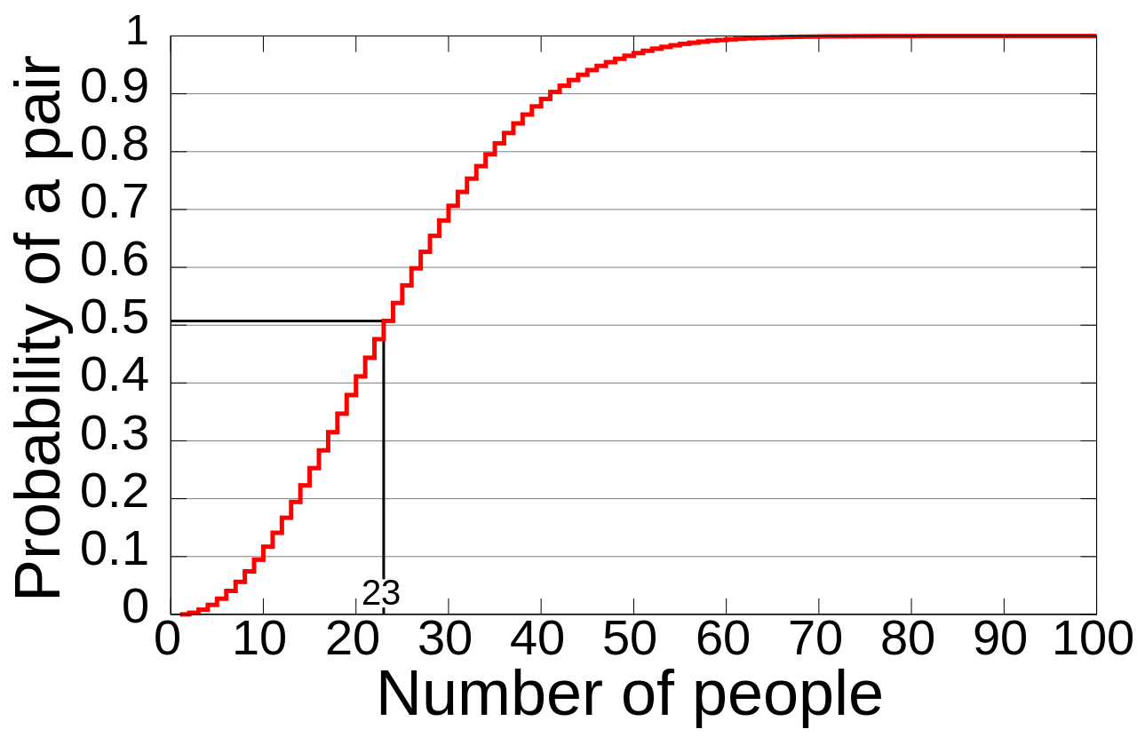
Hash functions
Problem with strong collision resistance
  Much harder to achieve than weak collision resistance
  Vulnerable to “birthday” attack
Computed probability of at least two people sharing a birthday amongst X people.
Notes:
Intuitively this can be understood as follows. Although it is difficult to find a person with the same birthday as you (probability 1 in 365), the likelihood that at least two persons in a group shares a birthday is much higher. Similarly, the probability of finding a plaintext / hash value pair with same hash value amongst a group of plaintext messages is much higher than identifying a plaintext with the same hash as a specific previous plaintext message.

Slide 68
Overview
A security model
Security goals
  Confidentiality
  Authentication
  Access control / authorization
  Data integrity
  Non-repudiation
  Availability
Security threats
Security mechanisms
  Encryption
    Symmetric encryption
    Asymmetric encryption
  Hash functions
  Message authentication codes

Slide 69
MAC
Message Authentication Code (MAC)
  “Cryptographic checksum”
  Uses both (plain)text and shared key as input
Additional functionality
  Checks whether message was modified
  Checks whether message originates from correct sender
  When counter is included in message: checks whether message order was preserved

Slide 70
MAC
secret key
client
Alice
server
Bob
plaintext
message
plaintext
message
plaintext
message
MAC
-fctn
MAC
MAC
MAC
-fctn
compare

Slide 71
MAC
MAC vs symmetric encryption
  Similarity: both sender and receiver share a secret key
    Similar authentication mechanism
    Drawback that receiver also needs to know secret key
  Differences with symmetric encryption
    No confidentiality function
    “Irreversible encryption”: decryption impossible
MAC vs hash function
  MAC also depends on secret key, while hash value only depends on message
Notation: MAC = C_{K}(M)
  where K: secret key ; M: message

Slide 72
MAC: authentication
Authentication of communicating entity Alice
  Only Alice can use this particular key in a communication with Bob
  Verification by Bob: recomputing MAC corresponding to received message using shared secret information
Authentication of transmitted message
  Modified message would yield different MAC
  Partial data-integrity
Adding counter sequence to message
  Impossible to tamper with message order
  Counter sequence secured by MAC
  Protection against replay

Slide 73
Examples
Example hash functions
  MD5 (not safe anymore)
  SHA family
    SHA-0, SHA-1, SHA-224, SHA-256, SHA-384, SHA-512, SHA-3
Further information
  Digital signature: Chapter 3
  Algorithms: Chapter 4

Slide 74
Test yourself
Explain the difference between confidentiality, authentication, access control / authorization, data integrity, non-repudiation and availability
Which of the above security goals are realized in the protocols from Chapter 3?
Why are sequence numbers (or nonces) added to messages? Is it a good idea to use a time stamp for this purpose?
Which counter measurements can be taken against DoS and DDoS attacks?
Give 5 examples of active attacks that can be used to compromise the security of a network protocol.
What are the strong and weak collision requirements? Give an example scenario describing why these are relevant.
What is the main difference between a digital signature and a MAC?

